Slide 1
Chapter 1:
Programming Review and Introduction to Software Design

Slide 2
Objectives
To review programming conventions
To review the good habit of writing functions
To define goals of software design

Slide 3
Software Design
A “Software design” is a set of documents on whose basis a software can be fully programmed.
A complete design should be so explicit that a programmer could code the application from it without the need for any other documents.
Software designs are like the blueprints of a building.

Slide 4
Documenting Functions: Programming Conventions: Method Documentation (1 of 2)
Preconditions: conditions on non-local variables that the method’s code assumes
  Verification of these conditions not promised in method itself
Postconditions: value of non-local variables after execution
  Notation: x' denotes the value of variable x after execution
Invariants: relationships among non-local variables that the function’s execution do not change
  Equivalent to inclusion in both pre- and post-conditions

Slide 5
Documenting Functions: Programming Conventions: Method Documentation (2 of 2)
Return:
  What the method returns
Known issues:
  Honest statement of what has to be done, defects that have not been repaired etc.

Slide 6
Exercise: Method Documentation
Suppose that you are building a class Account. Suppose that the class has a boolean variable open, as well as an int variable balance that is to be in the range -1,000 to 1,000. Suppose that you want to implement a method add( int anAmount ) that adds anAmount to balance, and returns the new value of balance. Also, assume that this method is meant to be called only if the value of open is true. Write appropriate documentation to be inserted within the comments prior to add().

Slide 7
Exercise Solution
Preconditions:
  open == true
  -1,000 <= balance <= 1,000
  -1,000 <= balance + anAmount <= 1,000
Postcondition:
  balance' == balance + anAmount
Returns:
  balance'

Slide 8
Key Concept: Specifying Methods
We specify each method in its comment section with preconditions, postconditions, returns, invariants and known issues.

Slide 9
Documenting Functions: Describing How a Function Satisfies its Specification
Activity diagrams (flowcharts)
  Graphical methods for depicting algorithms
Pseudocode
  A means of expressing algorithms without getting bogged down in the details of programming languages

Slide 10
Example: Activity Diagram
Draw an activity diagram (flowchart) for a command-line address book that allows you to store a name and an address on a predetermined text file. The user can add and retrieve entries. Entries can be retrieved by name. Editing is not required. Here is a typical interaction.
  >> Add (a) or retrieve (r)
  a
  >> Name:
  Eric Braude
  >> Address:
  2 Main St. Mytown, AZ 12345
  >> Add (a) or retrieve (r)?
  r
  >> Name:
  John Doe
  >> The address is: 33 Main St. Yourtown, MN 98765

Slide 11
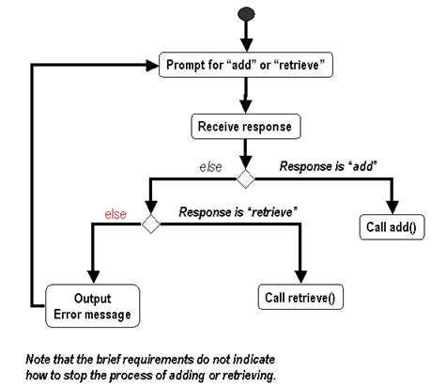
Example: Activity Diagram (Con’td)
main() method

Slide 12
Exercise: Activity Diagram
Draw an activity diagram (flowchart) for the add() method in the previous example.

Slide 13
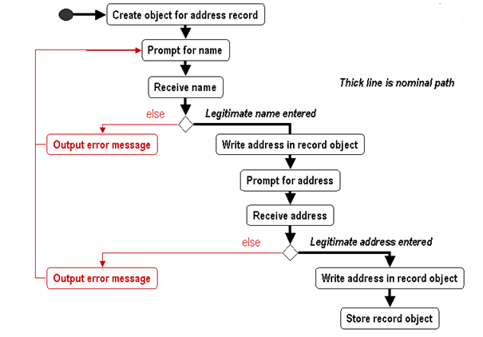
Exercise Solution
name

Slide 14
Pseudocode Example for an X-ray Controller
FOR number of microseconds supplied by operator
    IF number of microseconds exceeds critical value
      Try to get supervisor's approval
      IF no supervisor's approval
        abort with "no supervisor approval for unusual
        duration" message
      ENDIF
    ENDIF
    IF power level exceeds critical value
      abort with "power level exceeded" message
    ENDIF
    IF ( patient properly aligned & shield properly placed & machine self-test passed )
      Apply X-ray at power level p
    ENDIF
ENDFOR

Slide 15
Advantages of Pseudocode & Flowcharts
Clarify algorithms in many cases
Impose increased discipline on the process of documenting detailed design
Provide additional level at which inspection can be performed
  Help to trap defects before they become code
  Increases product reliability
May decrease overall costs

Slide 16
Disadvantages of Pseudocode & Flowcharts
Create an additional level of documentation to maintain
Introduce error possibilities in translating to code
May require tool to extract pseudocode and facilitate drawing flowcharts

Slide 17
Good Habits for Writing Functions (1 of 2)
Use expressive naming: the names of the function, the parameters and the variables should indicate their purpose
  … manipulate( float aFloat, int anInt ) ← poor
  … getBaseRaisedToExponent( float aBase, int anExponent )
Avoid global variables: consider passing parameters instead
  … extract( int anEntry ) { …… table = …. } ← replace?
  … extract( int anEntry, EmployeeTable anEmployeeTable )
    But not when the number of parameters exceeds ± 7
Defend against bad data
  Check parameter and other input values
    Use exceptions – or –
    Use defaults

Slide 18
Good Habits for Writing Functions (2 of 2)
Give names to numbers
    for( i = 0; i < 8927; ++i ) ← poor: why 8927?
    Instead:
    int NUM_CELLS = 8927;
    for( cellCounter = 0; cellCounter < NUM_CELLS; ++cellCounter )
Limit number of parameters to 6 or 7
Introduce variables near their first usage
Initialize all variables
Check loop counters, especially for range correctness
Avoid nesting loops more than 3 levels
Ensure loop termination
Inspect before compiling

Slide 19
What is Design?
The purpose of design is to produce a solution to a problem:
  The problem: requirements specification.
  The solution: your description of how the requirements are to be met.
Design is the creative process of describing and transforming a problem into a solution.
A set of documents on whose basis a software can be fully programmed.
Software design describe:
  The system well enough that coders can build it and deploy it without serious problems.
  All the parts of the system and how they fit together (architecture, high-level design)
  Each part in detail so that it can be coded.

Slide 20
Goals of Software Design
Correctness
Robustness
Flexibility
Reusability
Efficiency
Reliability
Usability

Slide 21
Correctness
Software design must satisfy the requirements for the application
Key Concept: Ensure Correctness
  We are primarily responsible for ensuring that our code does what it’s intended to.

Slide 22
Robustness
A design or implementation is robust if it is able to handle miscellaneous and unusual conditions such as bad data, user error, programmer error, and environmental conditions.
Key Concept: Write Robust Code
  Good designs withstand anomalous treatment.

Slide 23
Flexibility
Requirements of an application can change in many ways.
  Design should be flexible to accommodate these changes.
Aspects of flexibility
  Obtaining more or less of what’s already present
    e.g. handle more kinds of account
  Adding new functionality
    Add withdraw to existing deposit function
  Change functionality
    Allow withdrawal to create an overdraft

Slide 24
Reusability
The trend in software is to reuse parts among applications
  Example, Java API --- a large, extensive body of widely reused classes
Types of reusability
  Object code (or equivalent)
    Example: sharing dll’s between word processor and spreadsheet
  Classes – in source code form
    Example: Customer class used by several applications
  Assemblies of Related Classes
    Example: the java.awt package
  Patterns of Class Assemblies
    To be covered in Design Pattern chapters 6 – 9

Slide 25
Key Concept: Design for Flexibility and Reuse
Good designs are more easily modified and reused

Slide 26
Efficiency
Efficiency refers to the use of available machine cycles and memory
Create designs and implementations that are as fast as required, and which make use of no more than available memory
Efficiency often contradicts with other design goal

Slide 27
Reliability
An application is reliable if it is relatively defect free
Metric for reliability
  Average time between failures
Clean designs make it easier for developers to produce error-free applications

Slide 28
Usability
An application has high usability if users find it easy to use
Usability is attained through human-interface design

Slide 29
An Example:
Command Line Calculator
Requirements for Command Line Calculator Example
  It begins by asking the user how many accounts he wants to open. It then establishes the desired number, each with zero balance.
  It asks the user which of these accounts he wants to deal with.
  When the user has selected an account, it allows the user to add whole numbers of dollars to, or subtract them from the account for as long as he requires.
  When the user is done with an account, he is permitted to quit, or to pick another account to process.

Slide 30
Problems with Command Line Calculator Implementation (1 of 2)
How can we tell from the code that all required functionality has been handled? (correctness)
If the user makes a mistake the system crashes or performs unpredictably (robustness)
  The following cause crashes
    Invalid number of accounts
    Invalid account
    Invalid amount to add (not an integer)
    Invalid string (not “stop” or “Quit application”)

Slide 31
Problems with Command Line Calculator Implementation (2 of 2)
Not clear what some of the method are meant to do (documentation)
Hard to modify, add or remove parts. (flexibility)
Executes fast enough? (speed efficiency)
Satisfies memory requirements? (space efficiency)
Class usable for other applications? (reusability)

Slide 32
Summary
A “Software design” is a set of documents on whose basis a software can be fully programmed.
Goals of software design
  Correctness
  Robustness
  Flexibility
  Reusability
  Efficiency
  Reliability
  Usability

